Slide 1
Week 7 Recitation
BIOCHEM 5722
Vibrational energy levels

Slide 2
Objectives
Work through the recitation questions on Carmen.
Introduce concepts relevant to the practice problems.

Slide 3
Questions?

Slide 4
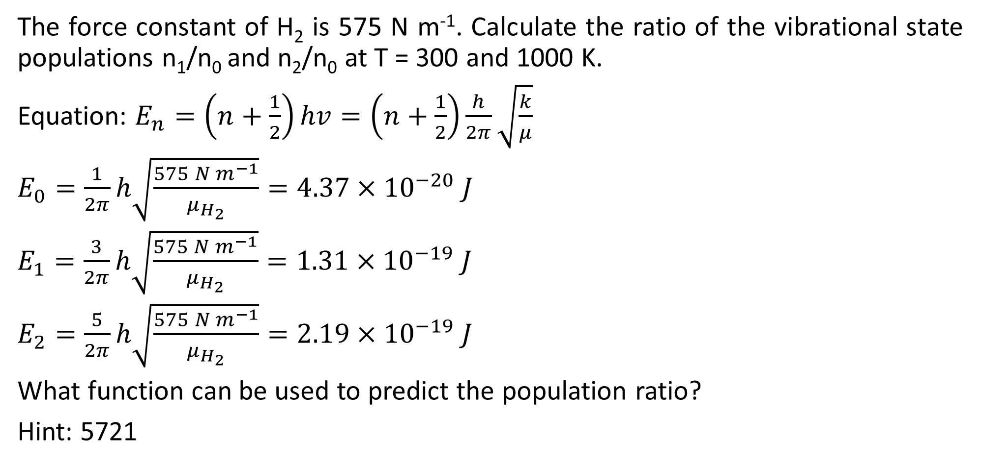
Q1
The force constant of H₂ is 575 N m⁻¹. Calculate the ratio of the vibrational state populations n₁/n₀ and n₂/n₀ at T = 300 and 1000 K.
Equation: $E_{n}=\left(n+\frac{1}{2}\right)hv=\left(n+\frac{1}{2}\right)\frac{h}{2π}\sqrt{\frac{k}{μ}}$
$E_{0}=\frac{1}{2π}h\sqrt{\frac{575 N m^{−1}}{μ_{H_{2}}}}=4.37×{10}^{−20} J$
$E_{1}=\frac{3}{2π}h\sqrt{\frac{575 N m^{−1}}{μ_{H_{2}}}}=1.31×{10}^{−19} J$
$E_{2}=\frac{5}{2π}h\sqrt{\frac{575 N m^{−1}}{μ_{H_{2}}}}=2.19×{10}^{−19} J$
What function can be used to predict the population ratio?
Hint: 5721

Slide 5



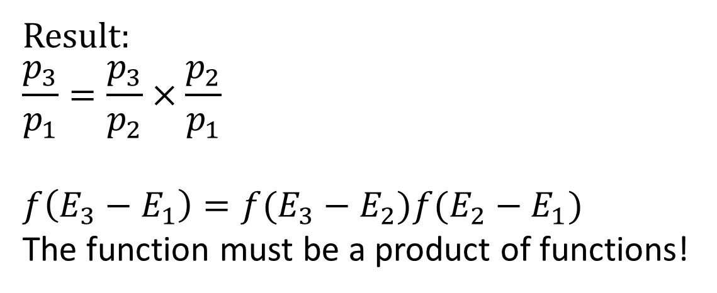
5721 Review: The Boltzmann Distribution
Recall: $\frac{3}{2}RT=\frac{1}{2}M\left\langle v^{2}\right\rangle$ , where $\left\langle v^{2}\right\rangle$ is the mean-square velocity of all particles
Consider two states, 1 and 2:
The population ratio of A and B depends on the difference between their associated energies, such that: $\frac{p_{2}}{p_{1}}=f(E_{2}−E_{1})$
What function f allows us to predict the population ratio?
Consider three states:
Result:
$$\frac{p_{3}}{p_{1}}=\frac{p_{3}}{p_{2}}×\frac{p_{2}}{p_{1}}$$
$$f\left(E_{3}−E_{1}\right)=f(E_{3}−E_{2})f(E_{2}−E_{1})$$
The function must be a product of functions!
$$p_{i}=Ne^{−βE_{i}}$$
3
E3 – E2 = p3/p2
$$β=\frac{1}{k_{B}T}$$
E3 – E2 = p3/p1
2
E2 – E1 = p2/p1
1
Notes:
This relation states the average kinetic energy of a system of particles is distributed around the average translational energy at a specific temperature.
Population ratio important because we cannot easily calculate population from energy – there is no practical absolute 0 energy state for comparison.

Slide 6
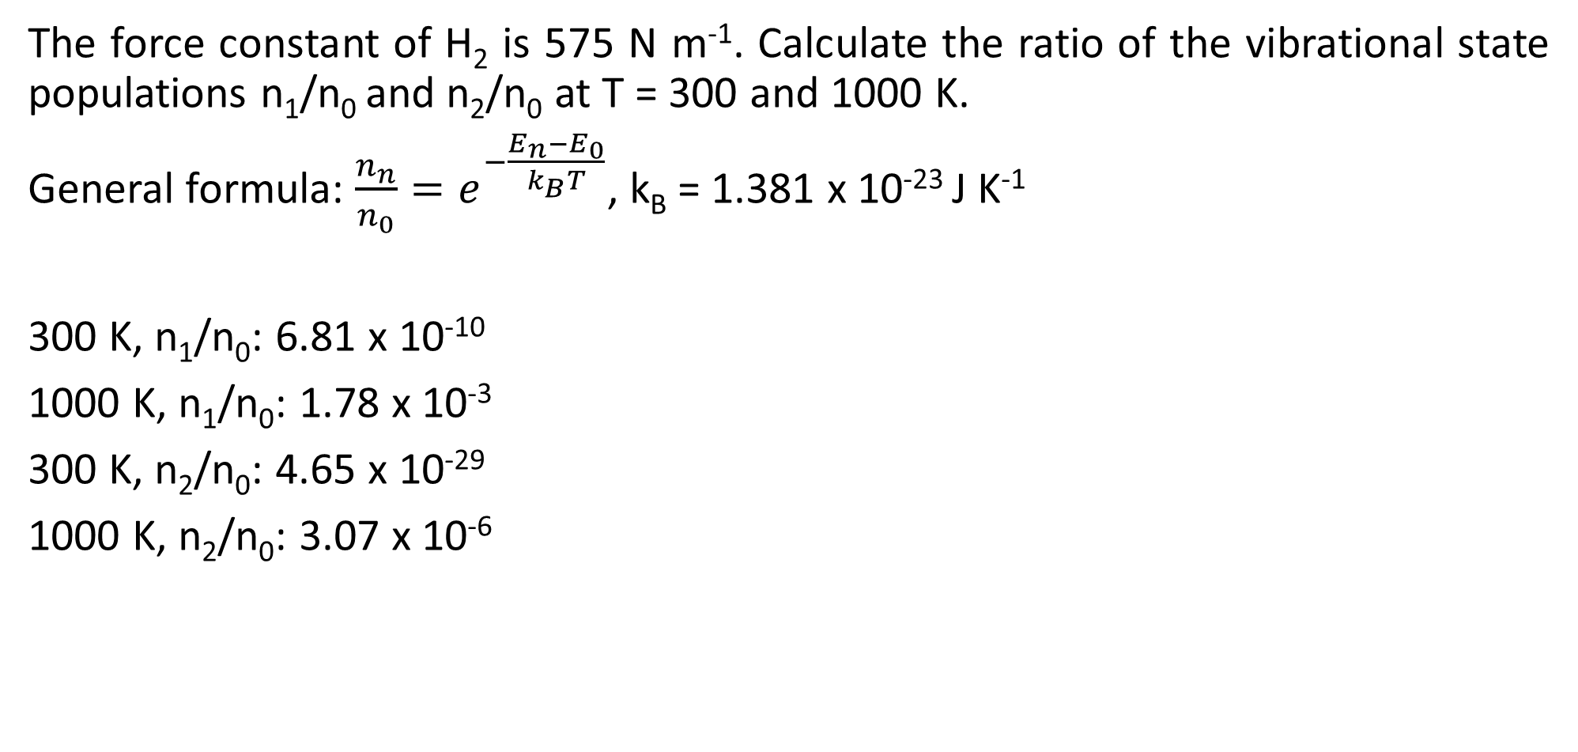
Q1 cont.
The force constant of H₂ is 575 N m⁻¹. Calculate the ratio of the vibrational state populations n₁/n₀ and n₂/n₀ at T = 300 and 1000 K.
General formula: ${\frac{n_{n}}{n_{0}}=e}^{−\frac{E_{n}−E_{0}}{k_{B}T}}$, k_{B} = 1.381 x 10⁻²³ J K⁻¹
300 K, n₁/n₀: 6.81 x 10⁻¹⁰
1000 K, n₁/n₀: 1.78 x 10⁻³
300 K, n₂/n₀: 4.65 x 10⁻²⁹
1000 K, n₂/n₀: 3.07 x 10⁻⁶

Slide 7
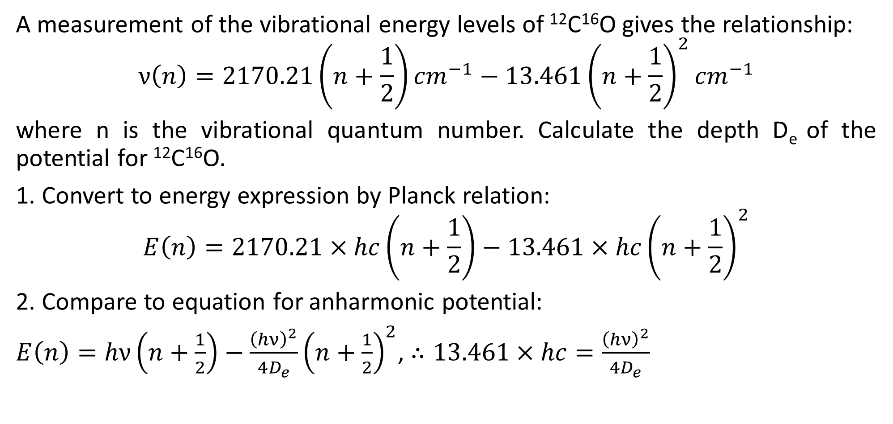
Q2
A measurement of the vibrational energy levels of ¹²C¹⁶O gives the relationship:
$$ν\left(n\right)=2170.21\left(n+\frac{1}{2}\right){cm}^{−1}−13.461{\left(n+\frac{1}{2}\right)}^{2}{cm}^{−1}$$
where n is the vibrational quantum number. Calculate the depth D_{e} of the potential for ¹²C¹⁶O.
1. Convert to energy expression by Planck relation:
$$E\left(n\right)=2170.21×hc\left(n+\frac{1}{2}\right)−13.461×hc{\left(n+\frac{1}{2}\right)}^{2}$$
2. Compare to equation for anharmonic potential:
$E\left(n\right)=hν\left(n+\frac{1}{2}\right)−\frac{{\left(hν\right)}^{2}}{4D_{e}}{\left(n+\frac{1}{2}\right)}^{2}$, $∴13.461×hc=\frac{{\left(hν\right)}^{2}}{4D_{e}}$

Slide 8

Q2 cont.
3. Redistribute the equation containing D_{e}:
$$D_{e}=\frac{{\left(2170.21×hc\right)}^{2}}{4×13.461×hc}$$
Answer: 1.738 x 10⁻¹⁸ J

Slide 9
Questions?
Have a good weekend!

